Slide 1
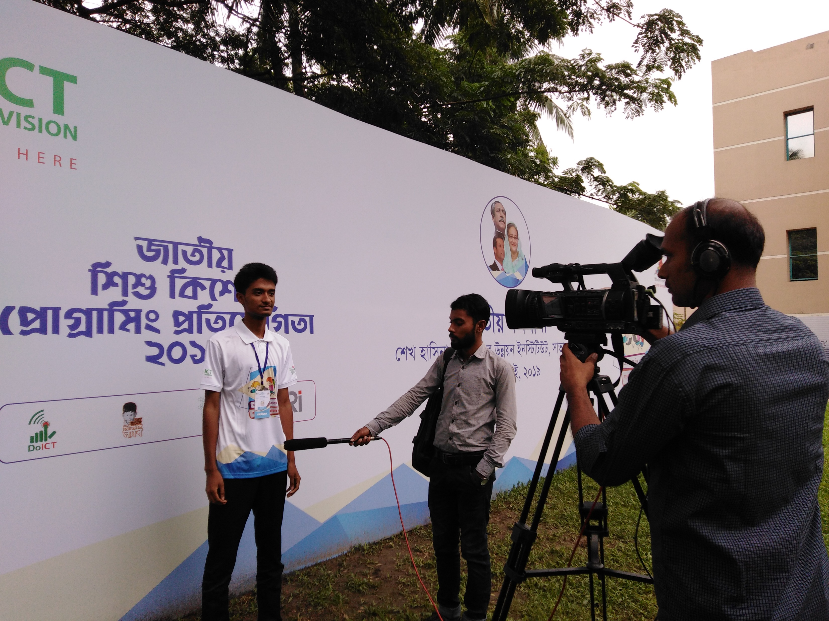
HELLO EVERYBODY
I am Ashikujjaman Himel. I have completed “Python Basic” in 2019, when I was in class 10.
And I also participated in “NTCPC – Python Programming Contest 2019” and obtained first place in whole Gazipur District. Then I participated at the national level in “NTCPC – Python Programming Contest 2019” to represent Gazipur District.
Also, recently I have revised “Python Basic” completely. So that, I think I can give you a full explanation of “Python Basic” and I hope you will enjoy this!
Thank You.

Slide 2
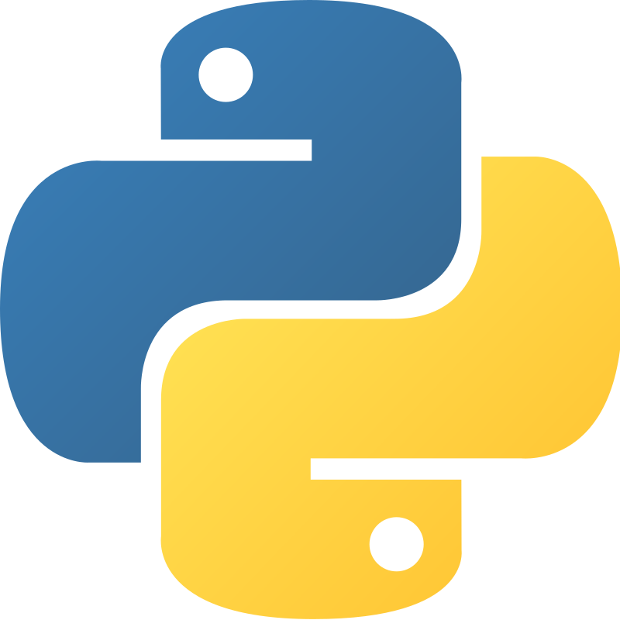
Python
What is Python
Python is a High Level, Easier and Object Oriented Programming Language.
Python was invented by Guido van Rossum in 1991.
Why Python
Python used for –
Backend Web Development
Software Development
Mathematics, etc.

Slide 3
Python Version
Python has two major version. They are –
Python 2
Python 3 (Latest)
Since, Python 3 is the latest version of python. So, you will learn Python 3 in this class.

Slide 4
Install Python
If we want to run python in our computer, we need to install python in our system.
First of all, we need to check via cmd if python is already installed in our system → python - -version
If not installed, we need to download python from python.org and install it like other software we install.
After installing, we need to make sure that we successfully installed python in our computer via cmd → python - -version
Done! We complete the python installation in our system. Now time to run python in our system.

Slide 5
Run Python
There are several method to write python code and see output in our system. The are –
Write python and see output in Online Compiler
Write python and see output via Python IDLE
Test python and see output via Command Prompt (cmd)
Write python in IDE and see output via Command Prompt (cmd)
Write python in IDE and see output via IDE Extension
We will use last one or, two method to write python and see it’s output.

Slide 6
Write Python and See Output
In the last slide, we saw 5 method to write python and see output. Now, we are going to see the process of 4th method of write python and see output. To write python and see it’s output –
First we need to open a project file and create a .py file inside it.
Then we need to open the project file in our IDE.
Write some code in .py file.
Then to see it’s output, we need to open cmd from the same directory where the .py file located.
Then write command to see it’s output. → python .py
Hurray! Now we can how to write python code professionally and see it’s output.

Slide 7
Python 3
Now it’s time to learn python 3!
print()
To see output in python, we must need to use print() method. Else, we can’t see output. Whatever we put inside the parenthesis of the print() method, it will be printed.

Slide 8
Python Comment
When we write long amount of code, it becomes difficult for us to understand that what we do in where. Python comment can help us there. Python Comment are not executable.
Python Comment is used for –
To understand code what we do where
To stop execute code
We can use two types of comment in python. They are –
Single Line Comment
Multiline Comment (It can done within two way)

Slide 9
Python Variables
Variables are used for store any types of data in python. It has a similarity with math.
Declare Variable
name = “Himel”
name, age, friend_list = “Ashik”, 20, [“Shimul”, “Sakib”, “Al-amin”]
name = short_name = nick_name = “Himel”
Print Variable
print(name, age, friend_list)
print(name + age + friend_list) [This will occurs an error!]

Slide 10
Rules for Declaring Variable
Variable Name
We need to declare variable with letters (A-Z and a-z), numbers (0-9) and underscore (_) only.
Variable names cannot starting with numbers (0-9)
Variable names are case-sensitive.
We can use global keywords to make variable global from local.
To define strings in variable, we can use single quotes or, double quotes. There is no difference between single quote and double quote.

Slide 11
Rules for Declaring Variable
Naming Convention
If we need to use multi-word variable name, we can use any naming convention from below –
Camel Case
Pascal Case
Snake Case
Unpack Collection
We can unpack data from list, tuple, set to variables. This called Unpack Collection.
friend_list = [“Shimul”, “Sakib”, “Al-amin”]
friend_1, friend_2, friend_3 = friend_list

Slide 12
Python Data Types
There are 15 built-in data types in python. They are -
String
Integer
Float
Complex
List
Tuple
Range
Dictionary
Set
FrozenSet
Boolean
Bytes
ByteArray
MemoryView
NoneType
We can use type() method to see the type of a data.

Slide 13
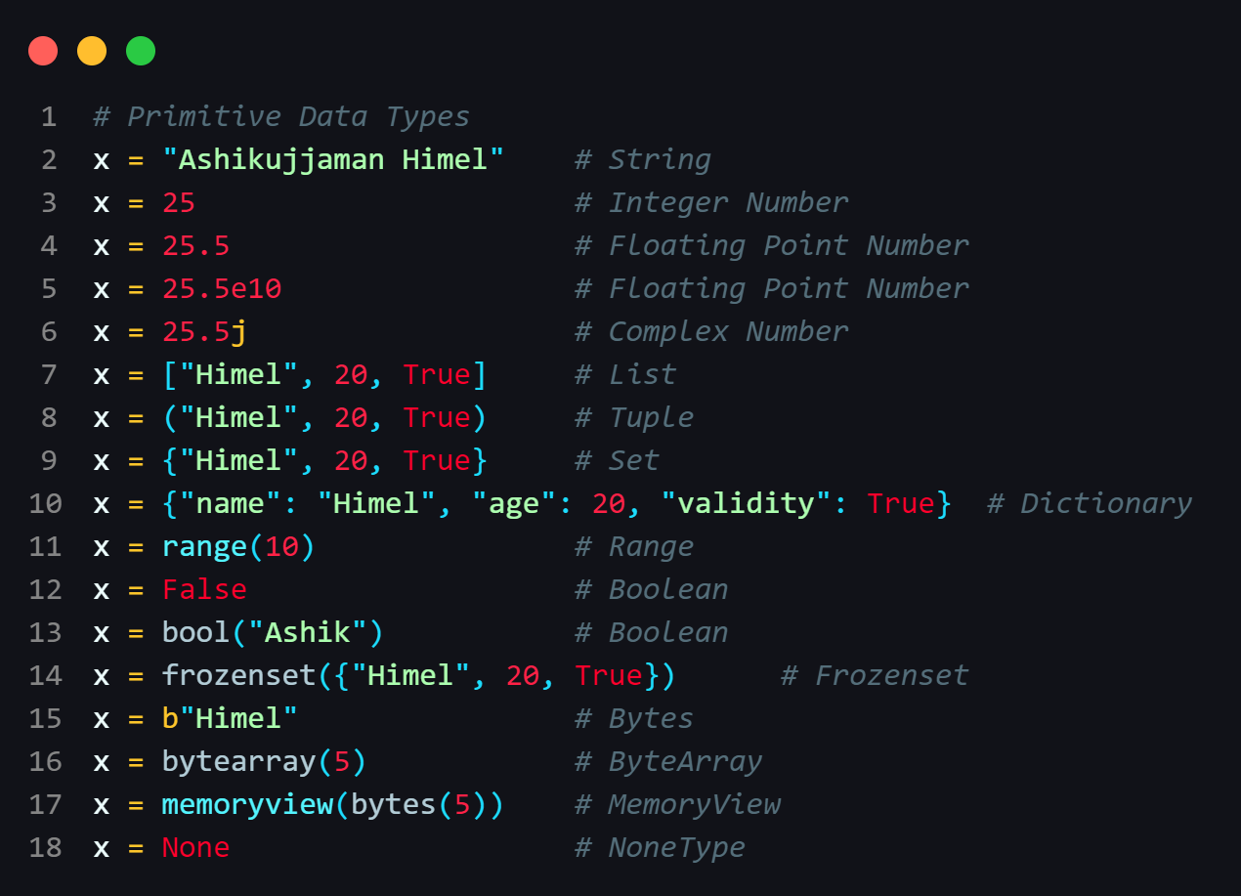
Python Data Types

Slide 14
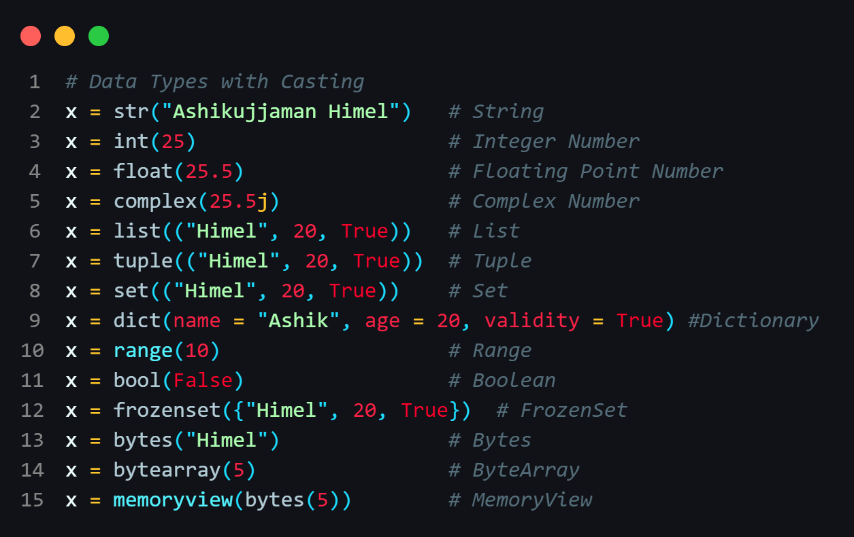
Casting
Declaring a variable with it’s data type, called Casting.

Slide 15
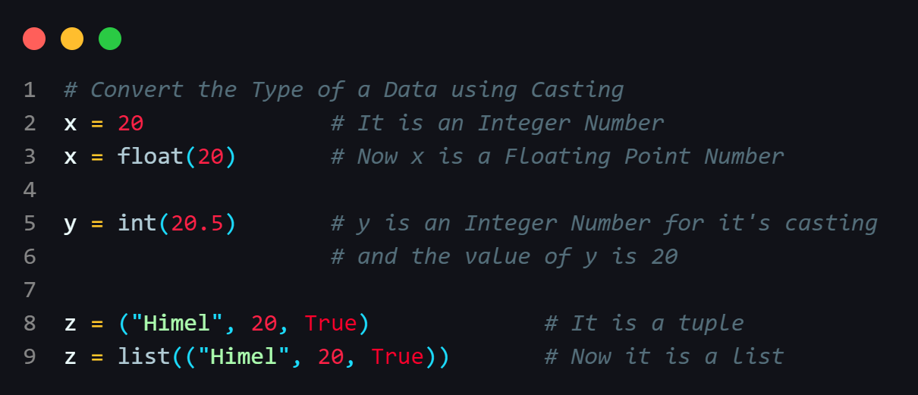
Convert Type of a Data via Casting
We can change the type of a data using Casting.
We can’t convert complex number to an another number.

Slide 16
Python Operators
In Python, There are 7 types of operators. They are –
Arithmetic Operators (+, -, *, /, //, %, **)
Assignment Operators (=, +=, -=, *=, /=, %=, //=, **=, etc)
Comparison Operators (==, !=, >, >=, <, <=)
Logical Operators (and, or, not)
Identity Operators (is, is not)
Membership Operators (in, not in)
Bitwise Operators (&, |, ^, ~, <<, >>)
We will discuss more about operator in the next class.

Slide 17
THANK YOU EVERYBODY
Programming is a very interesting addiction, If you can dive into it!

